Slide 1


Patient Module
LVCT Health
Lyani Sitti – Supply Chain Specialist

Slide 2
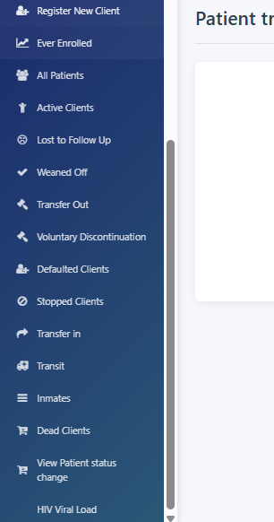
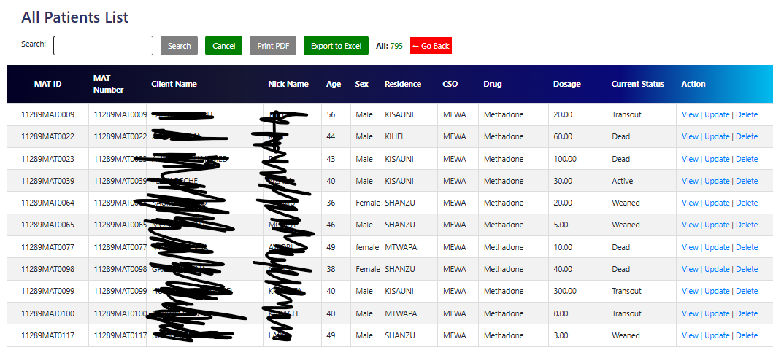
Search client

Slide 3
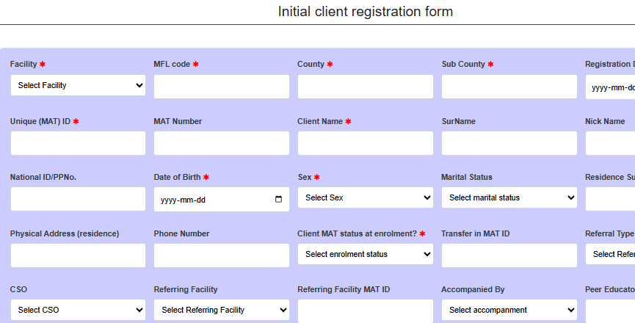
Register New client

Slide 4

Exercise
Register 7 clients
On Buprenorphine
On methadone
Transfer in
Transit
2 New
In prisons

Slide 5


Success

Slide 7


THANK YOU
Contact us
www.lvcthealth.org www.lvctgroup.org www.one2onekenya.org
@LVCTKenya
@lvctKe
LVCTHealth
TheLVCT

